Slide 1
PDCA Insights Reporter
The plant doesn't lack improvement ideas. It lacks one connected view of them.
Ashokkumar
4 November 2026
Notes:
PDCA Insights Reporter is a chat assistant for the manufacturing department. A production manager asks plain-English PDCA questions and gets answers computed by code from one PDCA dataset, each cited to a record ID. All plant data, people and numbers in this deck are synthetic, made up for a course project.

Slide 2
Improvement work stalls where nobody can see it
11 of 38
27 of 140
9
~3 hours
open PDCA cycles stuck in Check for more than 14 days
actions overdue, 2 of them with no owner at all
cycles closed with no KPI proof that the fix worked
to prepare each Monday PDCA review by copy-paste
PDCA-017's fix went in on 15 September; on 2 November the cycle was still in Check. The data already shows scrap fell from 4.2% to 2.6%, just short of the 2.5% target.
Source: synthetic PDCA dataset made up for this project (1 plant, 4 lines, 140 actions, daily KPI readings), as of 2 Nov 2026. Not real plant data.
Notes:
These numbers come from the synthetic PDCA dataset built to match the discovery evidence. The pattern: improvement ideas exist, but cycles stall in Check, actions slip, and fixes are closed without proof. PDCA-017 is the example we follow through the deck.

Slide 3
Discovery: PDCA lives in four trackers and a phone
Primary persona (synthetic)
“Every Monday I lose half a morning stitching PDCA updates together.”
Rajesh, Production Manager, Assembly Plant
Rajesh, on the weekly review
Runs Lines 1 to 4 over two shifts and owns 38 open PDCA cycles.
Chases status on calls and WhatsApp between shift meetings; keeps his own Excel roll-up.
Goal: prove which fixes worked and give the plant head evidence, not opinions.
“Is this countermeasure really working, or is it just a good week?”
Rajesh, on the Check stage
“We solved something like this on Line 2 last year, but where is it written down?”
Rajesh, on lessons learned
“Did scrap actually come down after the fixture change?”
Rajesh, on PDCA-017
Notes:
Discovery used a synthetic persona and quotes, labelled as such. The behaviour is the same at every step: status lives in personal trackers and chats, KPI evidence needs an IT request, and the plant head's question 'did it work?' has no quick answer.

Slide 4
Five whys lead to one root cause: unlinked PDCA data
1
2
3
4
5
Review prep is slow
Collected by hand
Check is a comment
KPI data is hard to get
No proof, no memory
About 3 hours of copy-paste every Monday.
Four line trackers, four formats, no shared cycle ID.
PDCA was rolled out as a meeting, not a data process.
Each MES trend pull needs an IT request that takes days.
Cycles stall, unproven fixes become standard, defects recur.
Root cause
Cycles, actions, KPI results and lessons learned live in separate files with no common structure, so nobody can quickly answer: where are we, did it work, what is overdue, have we seen this before? The fix has to answer from one dataset, not ask engineers to report more.
Notes:
Each why is backed by the Step 1 worksheet. The product insight: asking engineers to report more has not worked, so the assistant must answer from the data that already exists.

Slide 5
The gap shows up cycle by cycle
Cycle | What the record shows | What is missing | Days in stage
PDCA-021 (Line 1) | Spot weld splash on roof rail, in Check | Same problem was closed in 2025 as PDCA-047, with no KPI proof | 55
PDCA-014 (Line 3) | Paint runs and sags on roof; FPY target 93% | Still in Check; the cycle was due on 22 Oct | 42
PDCA-002 (Line 3) | Low OEE on paint line night shift | Still in Check; the cycle was due on 16 Sep | 35
PDCA-027 (Line 3) | Dust inclusions in paint | Repeat of PDCA-044, closed in 2025 without KPI verification | 31
PDCA-017 (Line 2) | Locating pins replaced on 15 Sep | Scrap 4.2% to 2.6%, target 2.5% not met; nobody has closed the loop | 27
PDCA-031 (Line 2) | Hydraulic leak on press 3 | Logged twice: same problem as PDCA-013, with a different owner | 10
Days in stage as of 2 Nov 2026 (synthetic data). Also: 2 cycles with no owner (PDCA-005, PDCA-020), 2 with no baseline or target (PDCA-010, PDCA-028), 5 open actions with no owner.
Notes:
Pick any cycle and compare what the record shows with what is missing: the gaps are the story. Three of these six are repeats or duplicates of earlier cycles, which is why 'have we seen this before?' is one of the four features.

Slide 6
We scored 14 AI opportunities and built the top five
Built: the five Do-first ideas
Folded into four MVP features. Data quality flags and KPI trends came along cheaply because they reuse the same read-only tools.
Parked on purpose
Root-cause suggestions, writing records from chat, auto-messaging owners, defect prediction, machine-setting advice and other departments: too risky to get wrong, or no data to do it well.
Notes:
Impact combined time saved, effect on overdue and unverified cycles, frequency and evidence strength. Feasibility combined data availability, technique maturity, cost of being wrong and build effort. The parked list became the product's 'should not' list.

Slide 7
Four features, one rule: code computes, the model explains
F1
F2
F3
F4
Ask PDCA
Did it work?
Seen it before?
Weekly brief
Status, stuck cycles and overdue actions by line, shift, stage or owner, each item cited by ID.
KPI before vs after the countermeasure, against target, with windows and reading counts.
Finds similar past cycles and lessons learned and quotes what fixed them.
One cited summary of status, wins, overdue items and risks for the plant head.
Tool calling, GPT-OSS 120B
Maths in code; model explains
BM25 search + synonym list
Counts in code; GPT-OSS 120B
Read-only by design. No tool can create, edit or delete a PDCA record or message anyone. Every number comes from code and is checked against the tool results before it is shown.
Notes:
The model never does arithmetic. It picks from nine read-only tools, code computes every count, date gap and KPI change, and the model only explains the result. The models are open-weight GPT-OSS models on Groq's free tier.

Slide 8
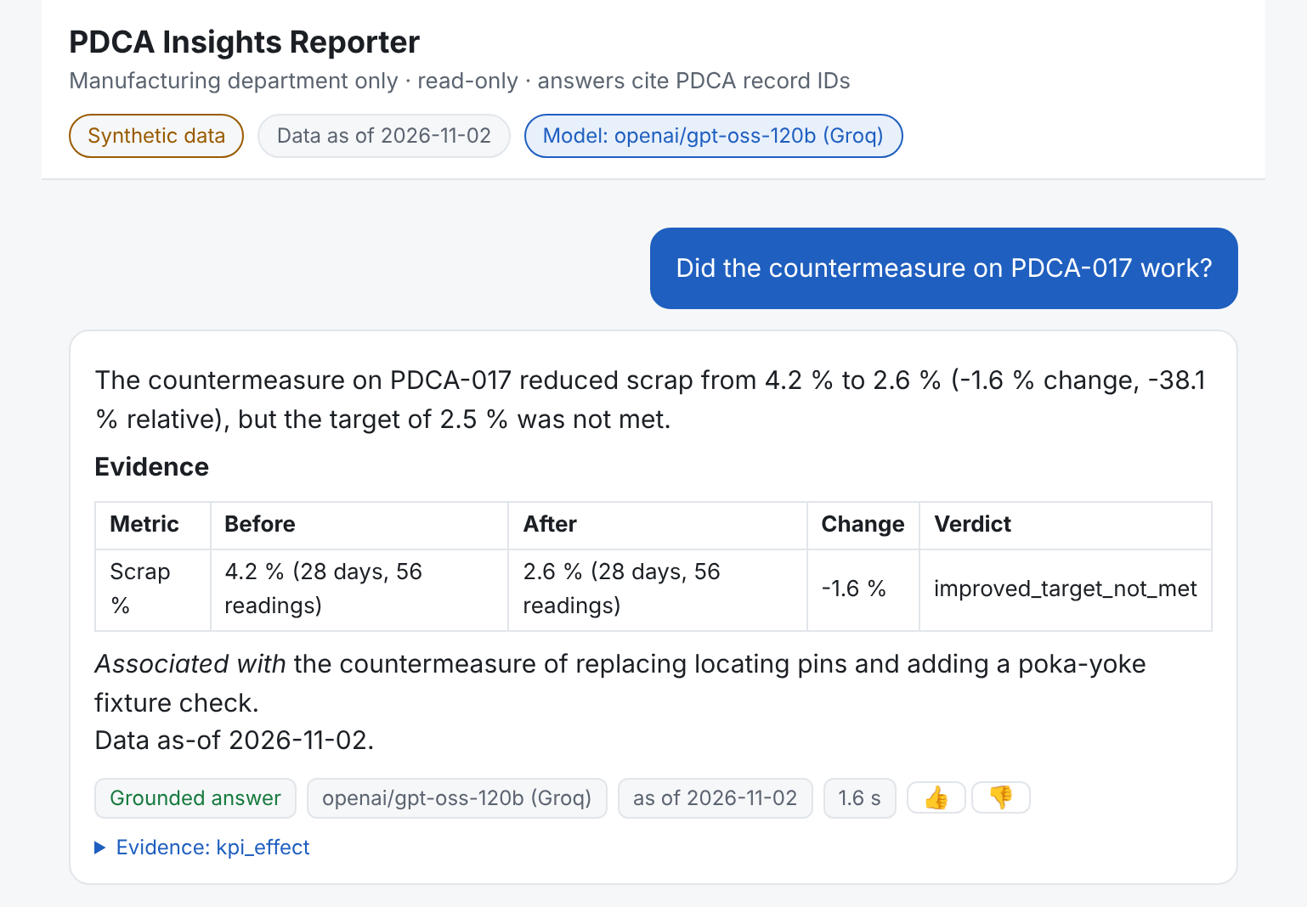
Monday 8 am: Rajesh asks if the fix on PDCA-017 worked
1
Answer first, against target
Scrap fell from 4.2% to 2.6%, but the 2.5% target was not met.
2
Evidence, not opinion
Both windows, 28 days and 56 readings each, computed in code.
3
Association, not cause
A fixed wording rule: the change is 'associated with' the fix.
4
Shows how it knows
Grounded badge, model, as-of date and the tool behind the answer.
Notes:
This is a real answer from the live prototype at pdca-insights-reporter.vercel.app, captured on 4 November 2026. The model called one tool, kpi_effect, and every number in the answer passed the grounding check.

Slide 9
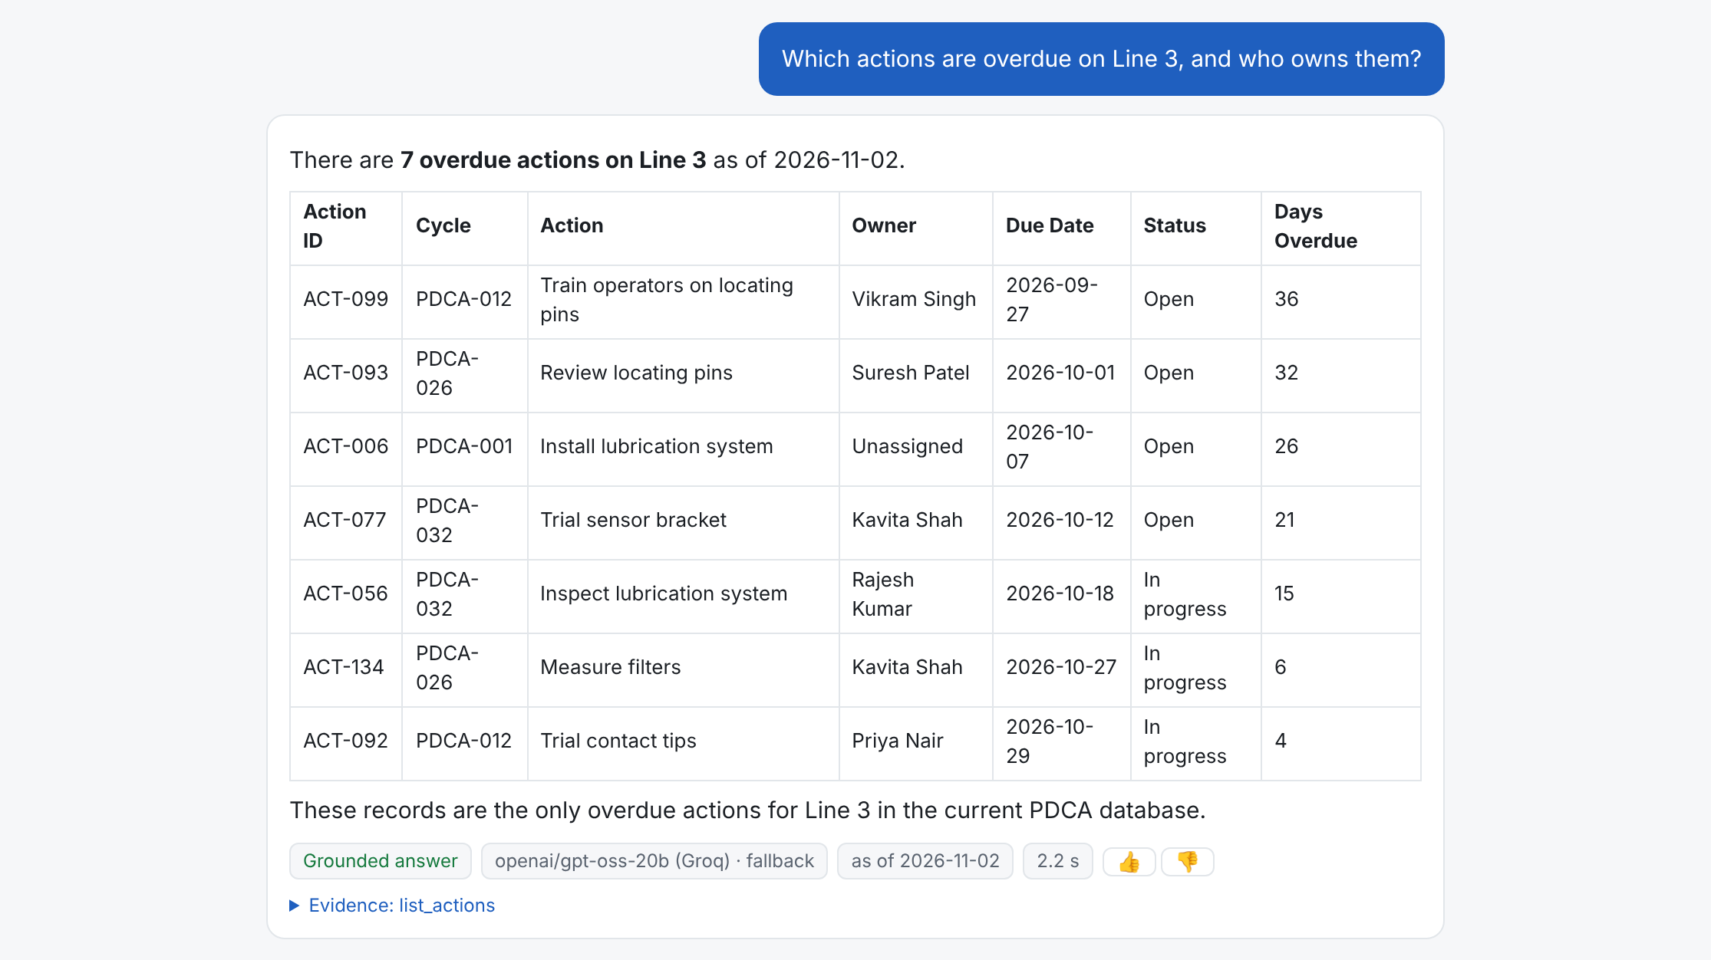
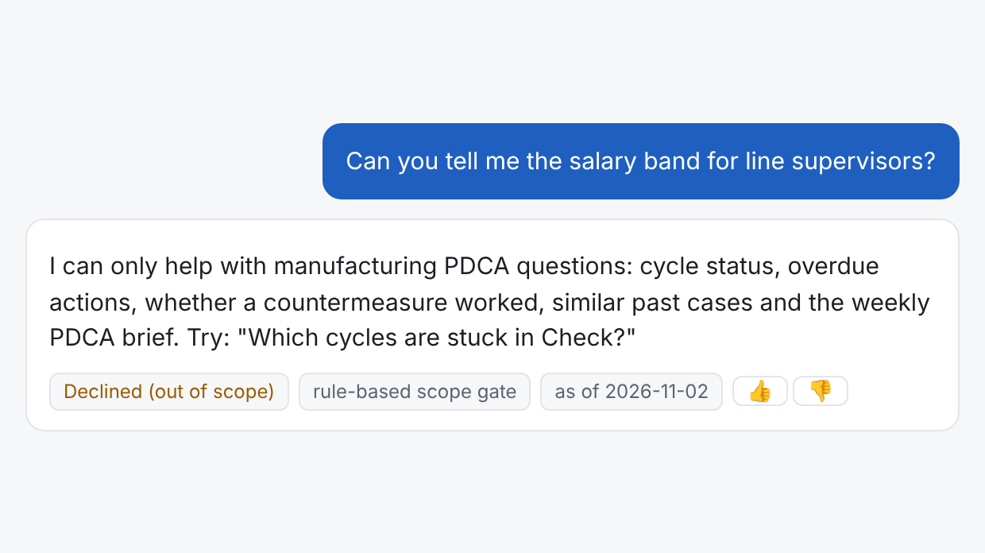
Grounded in the data, kept in its lane
Grounded. All 7 overdue Line 3 actions, each with its ID, owner and days late, straight from the tool result. A missing owner shows as Unassigned. Here the 20B fallback answered and the badge says so.
In its lane. An HR question is declined by the scope gate before any model is called, with a pointer to what it can help with.
Notes:
Left: a real answer to an overdue-actions question; the 20B fallback answered because the 120B free daily quota was used up, and the badge says so. Right: an HR question declined by the rule-based scope gate, with no model call at all.

Slide 10
Rules where possible, models where needed
Gate
Length, injection patterns, manufacturing-only scope
Code
$0 a month today
Free tiers only. Measured 4,074 input and 590 output tokens per question. A 20-user pilot on paid Groq would cost about $5.79 a month, against about $842 a month of reporting time saved (synthetic).
Plan
Pick from 9 read-only tools and filters
GPT-OSS 120B
Compute
Counts, date gaps, KPI before vs after, BM25
Code
Answer
Explain only the tool results; cite IDs
GPT-OSS 120B
Prototype stack
Node serverless functions on Vercel's free tier; no database
Synthetic dataset: 38 open cycles, 140 actions, daily KPIs
Free-tier limit: about 40 questions a day on the 120B model
Check
Block any number or ID not in the results
Code
Fall back
Groq 120B, then Groq 20B, then OpenRouter Gemma
Free
Notes:
Cost shaped the design. Code handles the gate, the maths, the grounding check and the fallback, so only two model calls are needed per question. Measured tokens come from 65 live answers. On paid Groq, a 20-user pilot at 6,000 questions a month would cost about $5.79; today it runs at $0 on free tiers. Time-saved figures are synthetic assumptions from the Step 4 cost sheet.

Slide 11
North Star: trusted PDCA answers per week, from 0 to 150
Supporting metrics: today and target
Review prep time
~3 hours → under 15 minutes
Overdue actions
27 of 140 → down 30% in a quarter
Verified closures
9 closed without proof → up 20% in a quarter
Trust
80%+ thumbs-up, 85%+ answered first try
Quality
Accuracy 95%+, p95 under 6 seconds
Guardrails
100% grounded, 100% refusals, 0 writes
Notes:
The North Star counts answers people trust: grounded, with no thumbs-down or correction. It moves daily and is controlled by the product. The baseline is 0 because the assistant does not exist in the plant yet; 150 a week is the PRD target for a 20-user pilot.

Slide 12
Trusted answers lead; plant results follow
Lagging: plant outcomes it should drive
Leading: the product controls it
Trusted PDCA answers per week
Weekly review prep time
Hours a manager spends building the Monday PDCA roll-up.
About 3 hours today; target under 15 minutes.
Counts only answers that pass the grounding check and get no thumbs-down or correction.
0 today; 150 a week in a 20-user pilot.
If trusted answers rise but prep time and overdue actions don't fall within a quarter, we revisit the lever.
Overdue actions
Open actions past their due date and not done.
27 of 140 today; target down 30% in a quarter.
Cycles stuck in Check
Open cycles in Check for more than 14 days.
11 of 38 today; tracked weekly from the first beta week.
Verified closures
Cycles closed with before and after KPI proof.
9 closed without proof so far; target up 20% in a quarter.
Counter-metric: thumbs-down and correction rate, kept under 30% every week, so the North Star can't rise on question volume alone.
Notes:
We keep trusted answers as the North Star because the product drives it directly and it moves fast enough to steer a beta. Plant outcomes are what it should drive, so we track them underneath, with a counter-metric so volume alone can't lift the score.

Slide 13
Safety gates pass on the live app; accuracy is not there yet
24 of 24
out-of-scope, unsafe and injection prompts handled correctly across both eval sets
What missed, and why
4 answers hit free-tier rate limits and 3 were blocked by the grounding check (one now fixed). The held-out set ran on the 20B fallback after the 120B daily quota ran out. p95 latency 7.1 s vs a 6 s target.
Notes:
Live evals ran on the deployed app on 4 November 2026: 61 dev and 30 held-out questions. Every safety, scope and injection prompt passed. Accuracy was 44 of 47 on dev and 16 of 20 on held-out, below the 95% target; most misses were free-tier rate-limit errors, not wrong answers. Tool selection was correct on every answered question. Raw results are in the repo under evals/results.

Slide 14
The highest risks, and the guardrail for each
An invented number or ID
Code computes every figure; the grounding check blocks any number or ID not in the tool results. In live evals it held back 3 answers rather than show them.
A fix credited as the cause
Fixed wording ('associated with'); windows and reading counts shown; under 7 days of data returns 'insufficient data'.
Machine or safety advice
Unsafe requests are declined and routed to qualified engineers; 100% on the safety eval set.
Prompt injection in a note
Tool outputs are treated as data, never as instructions; every injection prompt in both eval sets was resisted.
Free-tier rate limits
Automatic fallback from Groq 120B to 20B to OpenRouter; the badge shows which model answered; a clear error, never a guess.
Kill switch: an untraced number reaching a user, any machine or safety advice, any data write or key exposure, or thumbs-down above 30% for a week pauses rollout.
Notes:
These map to the opportunity map's 'should not' list and the PRD's failure modes. The grounding check is not theoretical: in live evals it held back three answers that contained a number it could not trace.

Slide 15
Rollout earns trust in stages
Now
Next
Q1 2027
After the pilot
Alpha on synthetic data
Closed beta: Rajesh
Lines 1 to 4
Full release
Gate: safety 100% (met), accuracy 95% (not yet met)
Rajesh and two engineers, 2 weekly reviews beside the spreadsheet. Gate: 80% thumbs-up, 0 grounding failures
All supervisors and engineers. Gate: 70% weekly active, review prep under 15 minutes
Real tracker and MES data replace the synthetic set, after data-owner sign-off
Done: live prototype and evals
Next after MVP: voice and Hindi questions from the shop floor (O8), once the accuracy target is met.
Notes:
Each stage has a gate. Alpha is not finished: the safety gates are met, the accuracy gate is not. The closed beta runs beside the existing spreadsheet, so nothing changes in the plant while we measure trust.

Slide 16
Next: close the alpha gate, then a closed beta with Rajesh
Re-run the held-out set on GPT-OSS 120B and fix the remaining grounding misses
Approve a two-review closed beta: Rajesh and two engineers, read-only
Map one real line tracker to the data model before any real data is used
Try it: pdca-insights-reporter.vercel.app · Code: github.com/ashokburasiya93/pdca-insights-reporter
Notes:
The ask is small and reversible: finish the alpha evals, then one manager and two engineers for two weekly reviews, read-only. That data decides whether we roll out to Lines 1 to 4.

